Slide 1


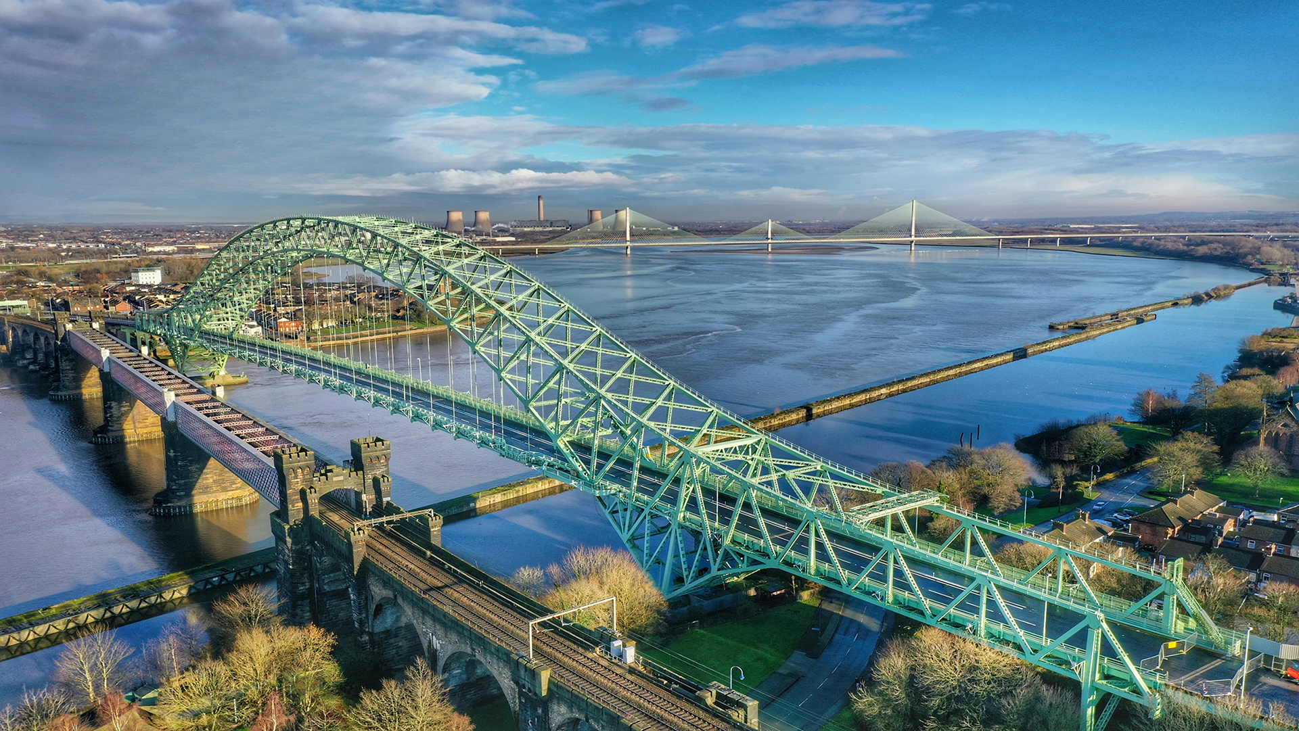

Public Scrutiny Meeting
Wednesday 29 April 2026
Runcorn Town Hall

Slide 2
Introductions

Slide 3
Minutes

Slide 4
Police & Crime Commissioner Scrutiny Panel
People Services – Assurance & Exceptions
April 2026

Slide 5

People Strategy

Slide 6
Workforce Establishment 26-27
Workforce position is stable, controlled and affordable
Category | Budgeted FTE | Percentage
Police Officers | 2401 | 59%
Police Staff | 1322.05 | 32%
PCSOs | 57 | 1%
Comms Operators | 186 | 5%
Specials/Volunteers (Average Actual FTE) | 136 | 3%
The workforce makes up 77% of the budget
25 Temporary contracts
9 agency workers
Notes:
Temporary Contracts:
25 staff (23.68 FTE) on fixed-term contracts (excluding externally-funded posts), including 3 apprentices.
21 of the contracts end prior to 31.03.27
There is redundancy liability for 5 of these staff.
Not renewing staff on FTC and deletion of the post offers potential savings for PBB13 without significant redundancy liability however, service level reductions would need to be considered.
Agency contracts:
9 staff on agency contracts (7 in Estates, 5 of which are cleaners). Most are part-time.
They often take on cleaners first via agency and if they are considered suitable, will then offer them a contract.
They are regularly reviewed to determine if still required or if FTC would more cost effective.

Slide 7
Workforce Numbers Split
Notes:
Officer numbers have steadily increased, reflecting sustained investment through the Police Uplift initiative launched in 2019 and, more recently, the Neighbourhood Policing Increase. Consequently, and as a result of budget constraints, PCSO numbers have declined over the past four years.
Police staff levels reached their peak in 2022/23 when the Blue Light Collaboration was fully operational, and the disaggregation of MFSS required additional staff to support the transition.
Since then, there has been a gradual reduction in police staff due to the disaggregation of the Blue Light Collaboration and the ongoing need for budget savings, while police officer numbers had to be maintained. See next slide

Slide 8
Neighbourhood Policing Guarantee (NPG)
Neighbourhood Policing Guarantee delivered for 2025/26
Neighbourhood officer establishment has increased by a net of 51.37 FTE. This is 3.68 above the 2025/26 target of 47.69.
PCSO variance managed
Home Office target confirmed for 2026/27 (+26 FTE)
 | Baseline FTE | Target Growth FTE | Current FTE | Growth YTD | Planned Future Growth (25/26) | Estimated Growth March 2026 | Difference to Target
Officers | 164.41 | 47.69 | 220.82 | 56.41 | 0 | 56.41 | 8.72
PCSO’s | 85.02 | 0 | 79.98 | -5.04 | 0 | -5.04 | -5.04
Total | 249.43 | 47.69 | 300.80 | 51.37 | 0 | 51.37 | 3.68
As at end of year – 31st March 2026

Slide 9
Workforce Capacity & Recruitment
Officer actual headcount: 2,433 (2,406 FTE)
Strong pipeline: 150 applicants live plus transferees
Early‑career officer attrition (national issue)
Mitigation: Recruitment assessment pilot; enhanced early‑service support

Slide 10
Specialist Capability: Detectives
Detective workforce at 87% capacity (372 FTE vs 427)
Position stable year‑on‑year
PIP2 accredited in‑post increased to 67%

Slide 11
Leadership, Standards & Performance
Promotion pipelines delivering sufficient leaders
National Police Leadership Programme ‑ aligned leadership training embedded
Performance & Talent Conversations at 96% completion
Leadership and standards are being actively managed

Slide 12
Health, Wellbeing & Sickness
Overall sickness below force target on average
Mental health highest cause (nationally consistent)
Occupational Health demand high but performance strong
As of 15 April 2026 | Officer | Staff | Grand Total | Abstraction Rate
Short Term Absence | 18 | 14 | 32 | 0.78%
Medium Term Absence | 28 | 16 | 44 | 1.07%
Long Term Absence | 47 | 48 | 95 | 2.31%
Grand Total | 93 | 78 | 171 | 4.16%

Slide 13
Sickness levels

Slide 14
Conduct, Casework & Trust
Ill‑health retirements within forecast
Low levels of live performance / misconduct action
Grievances stable and proportionate

Slide 15
Diversity, Inclusion & Culture
Disability and LGBT+ declaration rates improved
Female representation stable
Detective Constable Entry Programme higher female applicants
Exception: Ethnic minority representation marginally reduced (intake profile)
Mitigation: Recruitment outreach and Race Action Plan activity
 | 31st March 2025 | 31st March 2026 | % Change
Disability | 6.21% | 6.64% | +0.43%
Ethnic Minority | 2.33% | 2.17% | -0.16%
Female Representation | 48% | 48% | 0%
Sexual Orientation not declared | 41.13% | 37.89% | -3.24%

Slide 16
Overall Risk & Forward Look
Workforce risks are known, controlled and governed
No immediate risks threaten operational delivery
Forward focus:
Delivery of 2026/27 NPG growth
Continued grip on specialist capability
Sustained emphasis on wellbeing and culture

Slide 17

Key Achievements

Slide 18
Commissioner’s Questions

Slide 19
AOB

Slide 20

Contact us

