Slide 1




Public Scrutiny Meeting
29 June 2026
Runcorn Town Hall

Slide 2
Introductions

Slide 3
Minutes

Slide 4
Police & Crime Commissioner Scrutiny Panel
Modernise
June 2026

Slide 5
Agenda
IT & Digital Strategy
AI Enablement Programme
Estates Strategy

Slide 6
IT & Digital Strategy
Strategic Purpose
  The strategy aims to create a modern digital environment supporting efficient and responsive policing across Cheshire.
Vision for Excellence
  Ambition to be the best police force through digital capabilities enhancing safety and operational effectiveness.
Innovation and Collaboration
  Focus on innovation, efficiency, and collaboration as key enablers for technology success in policing.
Emerging Technologies
  Emphasizes adoption of cloud, automation, and AI to drive efficiencies and future-ready policing.
Local Policing Priorities
  The strategy supports the Police and Crime Plan 2024-2028 focusing on public confidence, victim support, and crime reduction.
National Digital Strategy Alignment
  Aligns with National Policing Digital Strategy 2025-2030 and Policing Vision 2030 for digital transformation in UK policing.
Core Ambitions and Enablers
  Focuses on protecting the public, seamless citizen experiences, empowered officers, and collaboration enabled by data and security frameworks.
Operational Effectiveness
  Integration of national systems like LEDS improves information sharing, data-led policing, and collaboration with partners locally.

Slide 7
Key Achievements
First UK adopter of Saab SAFE product for Force Contact Centre and continued to work with supplier to develop future generations for other customers.
Fully refreshed WAN infrastructure to support the needs of the organisation and continual updates of key infrastructure components
Continued refresh programme of end user devices ensuring front line staff have the equipment they need to carry out their roles effectively.
Continued to develop bespoke apps using in-house team, meeting the needs of our staff and streamlining tasks. Supplied apps to other forces.
Leading on cyber – IT Security team were winners of NPCC Cyber Excellence awards
Identified Motorola radio issue and fix, presenting to worldwide engineering teams. First UK force to take next generation radios.
Brought automation in-house, expanded use, saved money, plus now delivering services for other UK forces. Continue to add new automations saving staff time.
Pioneer force for LEDS Driver product (PNC Replacement) and worked with national agencies to simulate cyber attacks
Rolled out CoPilot to all staff across the organisation
Overhauled Digital Delivery – all delivered from within IT Services, and single governance structure
Notes:
Saab – Market has contracted in this area. This platform allows FCC to adapt and update themselves rather than wait for supplier.
WAN – recent refresh with Virgin. Ensuring an up-to-date and fit-for-purpose underlying network that will last for many years into the future.
End User Devices – a lot of staff were complaining about their devices back in 2022. Made it a mission to refresh devices and reduce life span down to 3 years. This has paid dividends, plus with recent market supply issues, this has impacted us less than most forces.
Apps:
Cell Check app – given that to other forces.
Victim Management
Heritage Crime – allows officers to record and information stored centrally allowing sites to be better protected.
Hospital handovers – ensures details of hospital, healthcare professional and other relevant details are passed to other staff efficiently.
Op. Encompass – enhancements made to help ensure schools have the information they need to support children and young people impacted by incidents within the home.
Automation – we provide automation to other West Coast Forces and plus generate a small income stream.
Problem Management – regular process to identify trends of calls coming into IT Service Desk where we take proactive steps to rescue.
CoPilot – first step in the AI journey. The AI team are now expanding and piloting the use of AI even further.
Digital Delivery – rather than have separate departments delivering individual projects, this is all run from within IT Services with a single Head of Service.

Slide 8
AI Programme Vision
To responsibly harness the power of Artificial Intelligence (AI) to enhance operational efficiency, data management, and support victims across Cheshire Constabulary, while delivering measurable cashable savings and upholding ethical standards, legal compliance, and public trust.
The programme will establish a framework for safe, transparent, and accountable AI use, addressing risks such as bias, data protection, and automated decision-making.
It will also guide the procurement, integration and review of new and existing third-party AI solutions, ensuring they align with Force values, the PCC's vision of modernisation and national standards.

Slide 9

Principles
Responsible Governance & Procurement
The AI Programme must be monitored, documented, and reviewed regularly to adapt to evolving risks and regulations.
Transparency & Accountability
All AI systems must be explainable, with clear documentation of decision-making processes and accountability structures.
Evidence Led
AI systems must have been rigorously tested, with transparent methodologies and clear accountability frameworks to maintain public trust in line with the NPCC’s AI Strategy.
Lawfulness & Data Compliance
All AI systems must comply with legal frameworks, data protection regulations and privacy standards.
Training & Skills
We will ensure that all officers and staff receive appropriate training to support ethical and effective use of AI. This will promote modern ways of working and digital leadership.
Value for Money & Benefits
AI will address identified problems that will enable faster, data-driven decision-making to improve public safety outcomes and better value for money.
Security by Design
AI solutions must be developed and deployed with robust security controls to protect data and systems and comply with the NPCC Responsible AI Checklist for Policing.
Ethical Use
AI must be used in ways that is accurate, promotes fairness, avoids bias, respects human rights and complies with the Data Ethics APP

Slide 10
Programme Objectives & Scope
Establish a Governance Framework
Develop Risk Assessment Tools
Evaluate & Embed Secure AI Systems
Pilot AI Technologies Safely
Engage Stakeholders in Design
Evaluate AI Output & Track Benefits
Train Staff on AI Awareness
Define vision and set up oversight boards. Ensure AI aligns with policy and national standards. Ensure proper management of resources and finances.
Manage DPIAs, EIAs, AI checklist, and bias assessments to support safe AI deployment.
Following discovery and evaluation – where appropriate AI use cases are identified, ensure that the solutions are embedded with relevant security measures.
Test AI solutions in controlled environments with safeguards for data protection and user transparency.
Involve diverse groups in AI development to ensure inclusive design and reduce bias.
Work with other forces and national partners, applying lessons learned.
Continuously assess AI performance, especially in decision-making contexts, to ensure fairness, accuracy, and realisation of intended benefits.
Provide training to ensure users understand AI capabilities, risks, and ethical considerations. Promote modern ways of working and digital leadership.

Slide 11
AI Enablement Programme
Dedicated Assistant Chief Constable and team of seven
October 2025: Programme initiated.
January 2026: Full scoping gathered 353 User stories, matched into core problem statements and themes.
February 2026: Solutions Development work commenced
April 2026: Outline Business Case presented.
June 2026: team has grown to 7 Internal staff
Operating inline with the NPCC AI Covenant and Playbook for AI in Policing.
Focus on ethical, transparent, innovative, economical and sustainable solutions.
University internship placement to be recruited for September 2026.
Steered away from commercial solutions, subscription services in the interests of control, applicability and value.
Majority of development is Microsoft Co-pilot due to being security approved.
Mainly “Human + Agent Assistant”, and “Human Led Agent” models.

Slide 12
External Validation
Approach endorsed by Home Office Analysis and Insights Unit – “genuinely impressed with your innovative approach”
Now a Microsoft ‘Frontier Force’ and 1 of only 3 UK police force’s informing and testing 2 international pilots.
Secured access as 1 of 10 worldwide projects for Microsoft’s Copilot Agency Factory

Slide 13
Key Achievements
Launched Co-Pilot Chat rollout in Policing for non-evidential use and material (3927 people trained).
June 2026 launch of Transcription in Microsoft Teams – seeking improved efficiency for officers and staff, in creating auditable, searchable records of meetings and briefings and providing greater transparency.
March 2026 deployment of TOEx into Specialist vulnerability, Online child abuse units, and Major Crime Investigations team giving translation support, transcription, and to receive and contribute to the national exploitation databases and management process
June 2026, Initial solution testing commenced for Interview transcription.
June 2026: Developing solutions to deliver efficiency savings and productivity gains across general business functions, Crime recording, Translation Support, Transcribing services and Force Intelligence in line with the outline business case.
Will enable us to provide more timely, more relevant, more accurate material and support to officers and the Public.
Additional Scoping of solutions for redaction of text and video for subject access requests and freedom of information creating a more efficient service for the public, whilst maintaining excellent credentials in this area. Supports us with being more transparent and responsive to the public
Examining new functionality on GoodSam in our Control Room to add quality assurance function and compliance to maintain our class leading performance. Includes a Responder App to allow officers to review location and footage or material relating to the incident. Intended that this will free up QA staff.
Testing Home Office “Prometheus” tool which enables triage through keyword searching of seized digital devices used in sexual offences. Enables us to more quickly focus on high harm offences.
Developing tools for further redaction within intelligence and pulling together daily briefing documents.
June 2026: STAR Stalking project – Proof of concept has been completed and moving to project close down report and the evaluation of initial pilot. Further development being identified, for a further bid. Suzy Lampugh trust, CoPSA

Slide 14
Ongoing Activity
Op Forward Planning: Building the requirements for a predictive policing proof concept to better align resource and capability with threat; to improve our ability to have the right resource, at the right place and right time
Further scrutiny in partnership with Justice UK.
Development work with Microsoft Funding to train our two operationally experienced, junior developers in the latest approach to building AI agents within the current suite of software.
Continued scoping of solutions for control room efficiencies, however at this point in time commercial solutions exceed budget and Return on Investment requirements

Slide 15
Estates Strategy
The Estates Strategy has 4 Core Principles:
  Police estate that is fit for the future
  Police estate at the heart of and connected with our communities
  Police estate that promotes effective collaborative working
  Police Estate that is economic, efficient and sustainable
Delivery Update
Building Projects
July 2025 - completed new Police Station at Wilmslow built to Passive Haus standards which assures its efficient energy usage and is the first such Police Station in the UK. The station is at the heart of the local community and was opened by children from St. John’s CE Primary School.
October 2025 – completed a new taser range within the Tactical Training Centre (TTC) that will enable the Constabulary to be one of the first Forces in the country to fully utilise the new taser.
January 2026 - commenced the building of a new deployment base in Crewe which is designed to have a net zero carbon footprint. Currently forecast to be completed on budget in Spring 2027.
Collaboration
We are continuing to operate the Armed Alliance with North Wales Police from our estate and to utilise the Tactical Training Centre with other law enforcement organisations.
We continue to share facilities with partners in the Probation Service and Cheshire Fire and Rescue Services.
Energy Efficiency
The Constabulary has a fixed price energy contract however we are cognisant of the increases in the cost of energy. We are exploring options for improved use of solar energy across the estate that will reduce our energy costs in the long-term including options at HQ to install an array of PV solar panels. We are also exploring options to build a small solar farm at the rear of our TTC and reviewing all other buildings across the estate for their current usage of solar panels and potential future usage of solar panels with battery storage options.

Slide 16
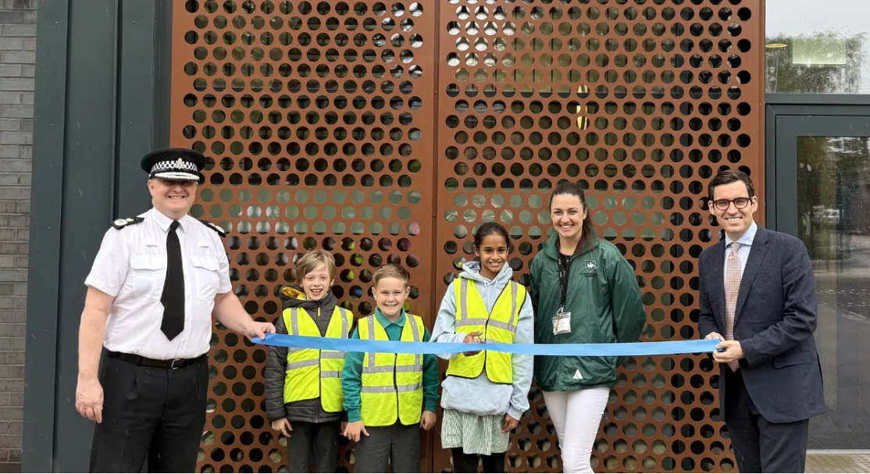
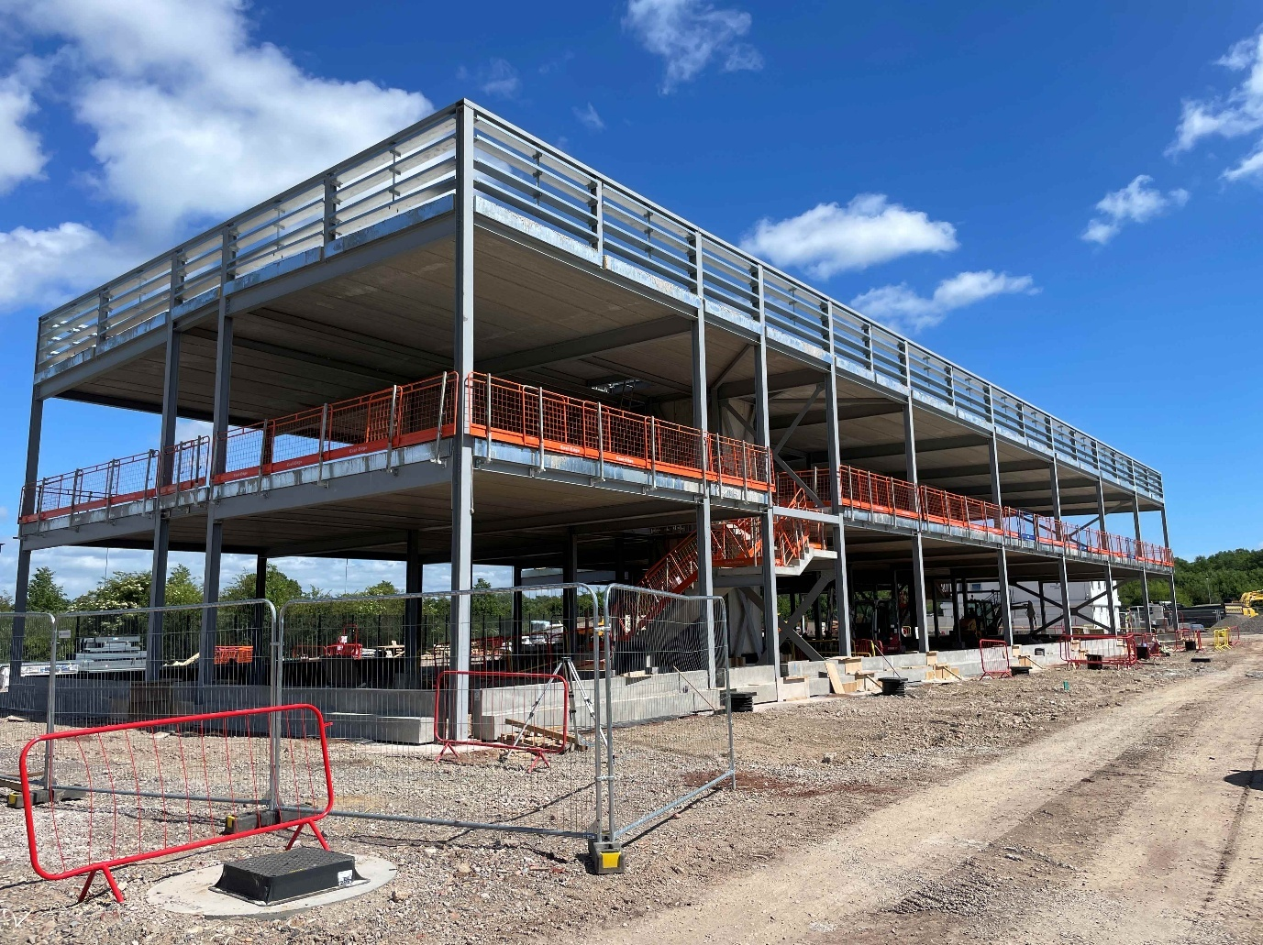
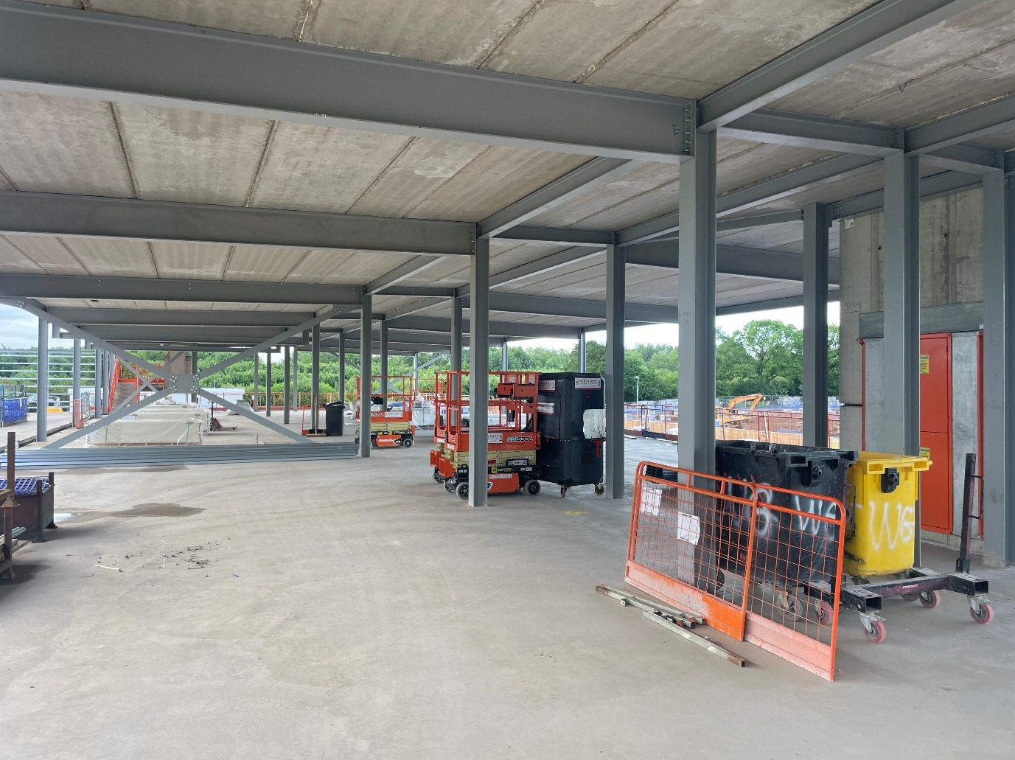
Estates Strategy
EV Requirements
We are reviewing all our buildings across our estate for their suitability to instal EV charging points. This will help us to understand our capacity for charging vehicles and will link to our review of solar panels and our Fleet Strategy.
The design of our EV charging capacity at our new deployment base at Crewe will include a combination of rapid chargers and slower time chargers to ensure we maximise the availability of vehicles and use of the charging points. It will give us flexibility across our Crewe based EV fleet whilst reducing the use of fuel.
Maintenance
Maintenance and upgrades continue across the estate. Our 9 LPU buildings and out 3 custody suites have all had upgrades to their rest rooms and their wellbeing rooms within the last 12 months. Similar upgrades to our other police stations are planned over the next 12 months
Opening Wilmslow Police Station
Building Crewe Police Station

Slide 17
Commissioner’s Questions

Slide 18
AOB

Slide 19

Contact us

